Slide 1

IoT Based Water Management System
Presented by
B. Hima bindu [17F21A0433] G. Likhith Krishna [17F21A0452]
J. Jyothendra Reddy [17F21A0439] V. Harini [17F21A0428]
A. Bala Manikanta Gowd [17F21A0408]
Supervisor :
Dr. K. C. Kullayappa _{M.Tech, PhD}
R&D Dean and Assoc. Prof
Dept. of E.C.E
GATES Institute of Technology
Gooty.
Department of Electronics and Communication Engineering GATES INSTITUTE OF TECHNOLOGY : GOOTY
(Approved by AICTE, New Delhi, Permanently Affiliated to JNTUA & Accredited by NAAC)
Gootyanantapuram (V), Gooty-515401, Anantapur (Dist.), A.P.
1

Slide 2
Contents
Introduction.
Problem statement.
Objectives.
Literature Review.
Existing System.
Proposed System .
Components.
Block Diagram.
Flow Chart.
Simulation Results.
Comparison between existing and proposed system
Advantages
Conclusion.
Future Scope.

Slide 3
Introduction
Water is the most essential one in our world. Water is readily available source in nature.
But now a day's lot of ground water level is decreased because of excess amount of water wastage.
In industries water plays major role in manufacturing, and processing unit.
Another major issue is water pollution, most of industries release the toxic wastes and chemical wet wastes to rivers and drainages, it greatly affects the life of people who lives near to the banks and people who consumes that water.

Slide 4
Contd.,
In this the system contribute towards water management system, this proposed system use IoT based automated system for controlling and monitoring of water management systems which supports internet-based data collection on real time bases.

Slide 5
Problem Statement
The traditional water management system could not limit the wastage of water and also cannot provide a complete survey especially in highly populated residential buildings.

Slide 6
Objectives
To develop the water management system using IOT technology to limit the water wastage and also to provide the complete survey
To measure the quantity of water distributed (to every household) by using flow rate sensors.

Slide 7
Literature Review
Authors : Anjana S; Sahana M N; Ankith S
Year : 2015
Title: An IoT based 6LoWPAN enabled Experiment for
Water Management
Description :
This system uses a presented (Internet Protocol version – 6)IPV6 network connected IoT design for real-time water flow metering and quality monitoring. . (Constrained Application Protocol)CoAP is used for monitoring and control approach which supports internet based data collection.
Limitations :
CoAP is still evolving, although there is a lot of market momentum behind it.
Security: Like MQTT (MQ Telemetry Transport), CoAP is unencrypted

Slide 8
Literature Review
Authors : Sai sreekar siddula; phaneendra babu; P.C. Jain
Year : 2018
Title: Water Level Monitoring and Management of Dams using IoT
Description :
This paper gives an outline for the development of an information system based on the existing systems with the utilization of some sensors and IoT.
it is composed of ultrasonic sensor, PIC (Peripheral Interface Controller) micro-controller, and GSM
( Global System For Mobile Communications ) module.
Limitations:
Limitations of GSM is that multiple users shares the same bandwidth.
GSM provides limited data rate capability .
In order to increase the coverage, repeaters are required to be installed.

Slide 9
Existing System
When the user uses the amount of water allotted for them, the controller gives the signal to solenoid valves, the solenoid valve will automatically cut the water supply to that particular user.
Here Arduino is used as a controller to control the overall process.
Limitation :
The user doesn't have any idea about the usage of water and at what volume, it exceeds the limited range, and what time the water supply is going to be cut.
There is no source that gives the information to the user.

Slide 10
Proposed System
The water usage is initially sensed by the water flow sensor and the sensed signal is send to ESP-32 [WIFI-Module].
The level of the water is indicated by using LED.
When the water consumption exceeds the present value then the signal is send to the solenoid valve, the solenoid valve automatically close the water supply.
The ESP-32 has inbuilt WIFI - Module is used to share the data from controller to cloud.
The cloud is connected with mobile application(BLYNK).
Through the mobile application the user can get the data.

Slide 11
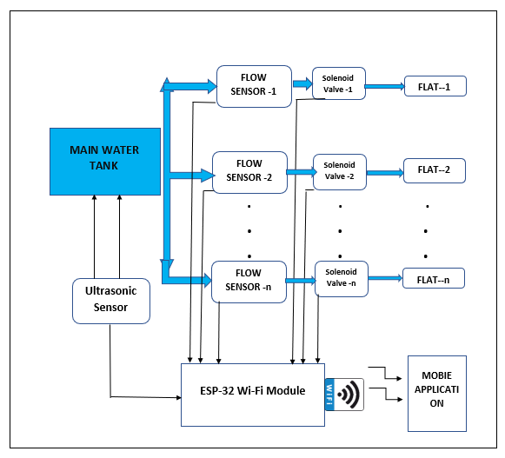
Block Diagram For The Proposed System

Slide 12
Components :-
NodeMCU (ESP-32).
Water Flow Sensor (YF-S201).
Solenoid Valve (12v - 1amp).
2 Channel Relay.
Ph Sensor board.
Blynk APP. (Mobile Applicaion)

Slide 13
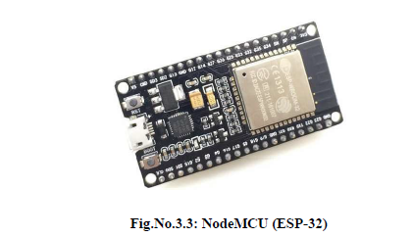
ESP-32
NodeMCU is an open source IoT platform. This includes firmware which runs on the ESP32 Wi-Fi Module from Espressif Systems.
Low energy consumption.
Integrated support for WIFI network.
Reduced size of the board.
Low Cost.

Slide 14
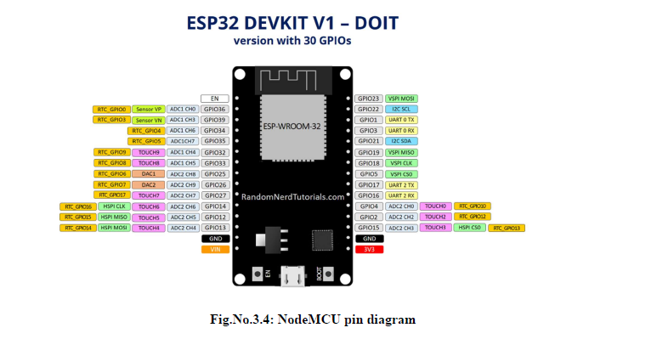
PIN-OUT of ESP-32

Slide 15
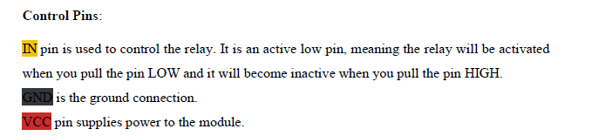
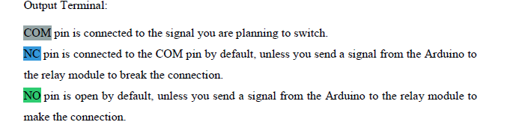
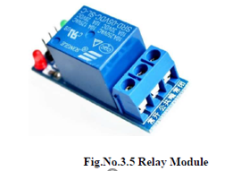
Relay Module
A relay is an electrically operated switch.

Slide 16
Water Flow sensor
Water Flow Sensor, as the name suggests, is a device to measure the flow of water.
Basically, the YF-S201 Water Flow Sensor consists of a Flap Wheel (or a Turbine Wheel) that spins when water flows through the sensor.
At the centre of this flap
wheel, there is magnet fixed.
Model: YF-S201.
Working Range: 1 – 30 L/min.

Slide 17
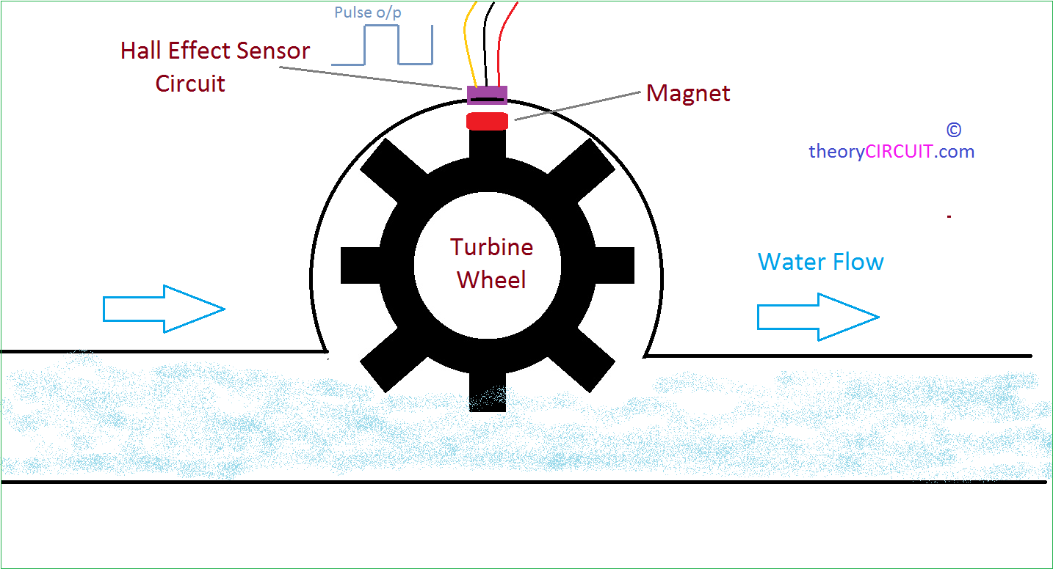
Working of flow sensor

Slide 18


Solenoid valve and its working
Solenoid valves are used wherever fluid flow has to be controlled automatically. They are being used to an increasing degree in the most varied types of plants and equipment.

Slide 19
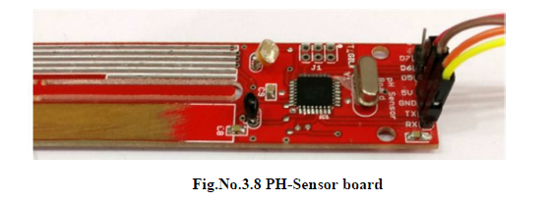
PH-Sensor Board

Slide 20
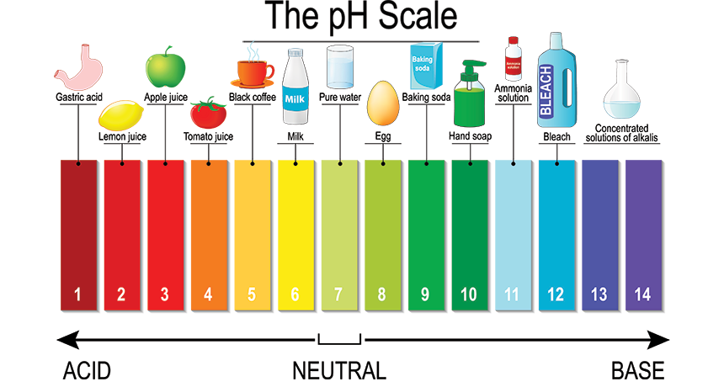
PH - Chart
Pure water (7-8)

Slide 21
BLYNK-APPLICATION
Blynk is a Platform with IOS and Android apps to control Arduino, Raspberry
Pi and the likes over the Internet. It’s a digital dashboard where you can build a graphic
interface for your project by simply dragging and dropping widgets

Slide 22
Flow Chart
start
All components are sensing the data
If water limit is crossed
No
Send an alert and text message is sent to mail
Yes
End

Slide 23
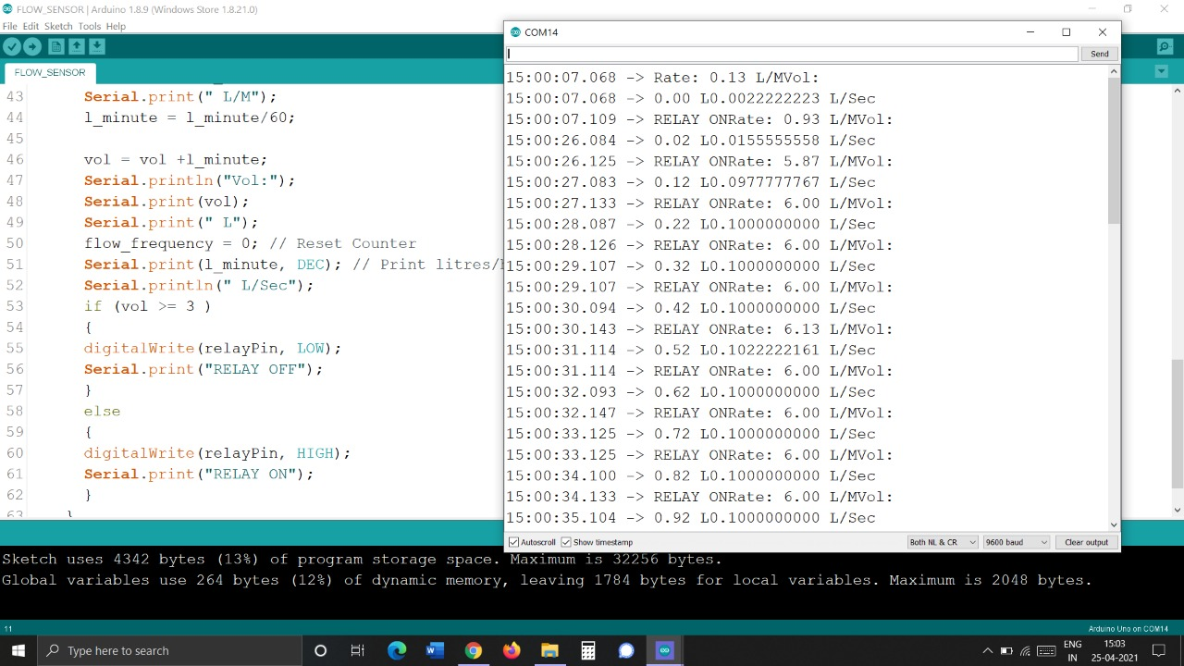
Simulation Results
Relay ON [solenoid valve is in ON position]
Maximum flow is 3 Lit

Slide 24
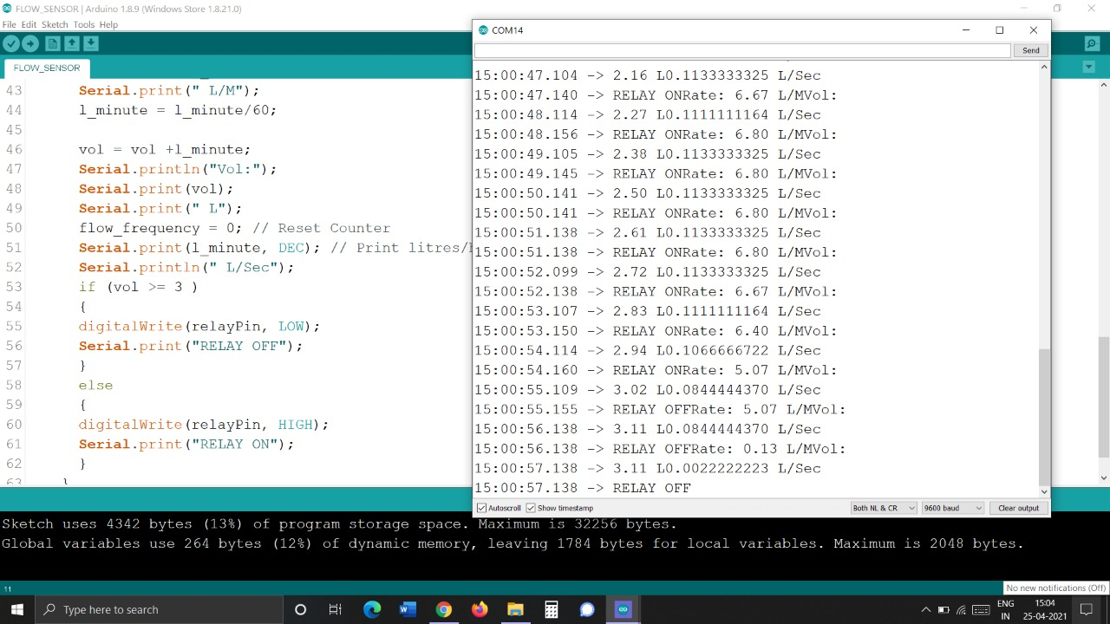
Relay off [solenoid valve is in off position]

Slide 25
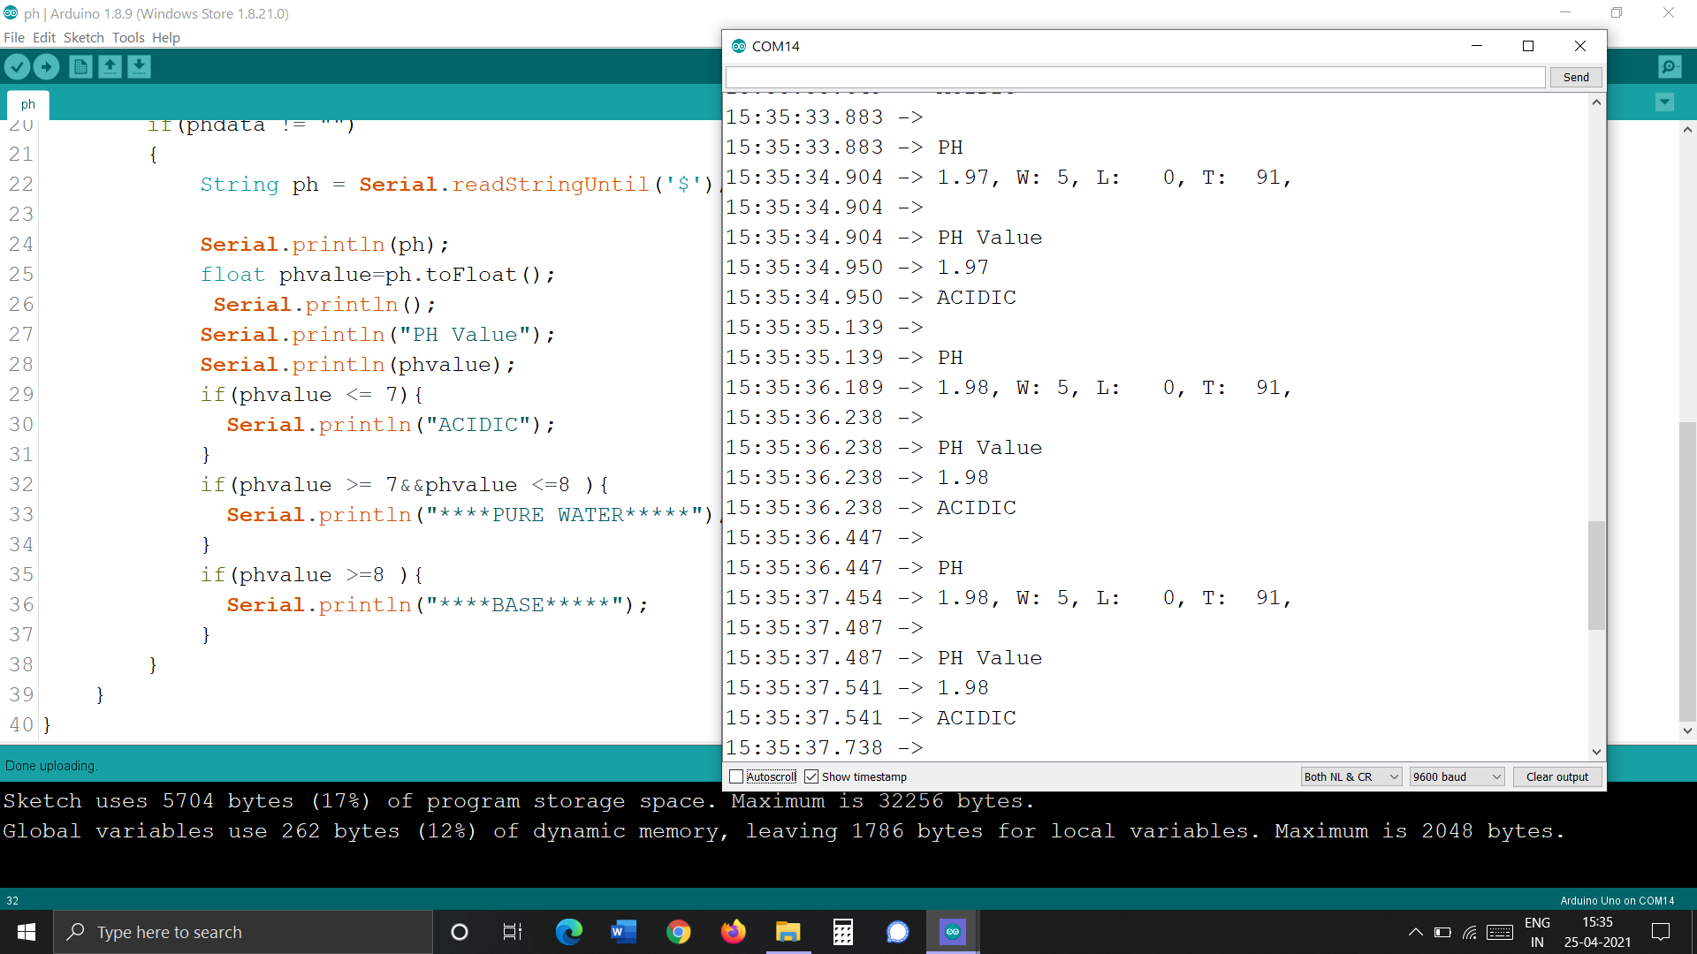
When dipped in lemon water
Values below “7” shows acidic in nature

Slide 26
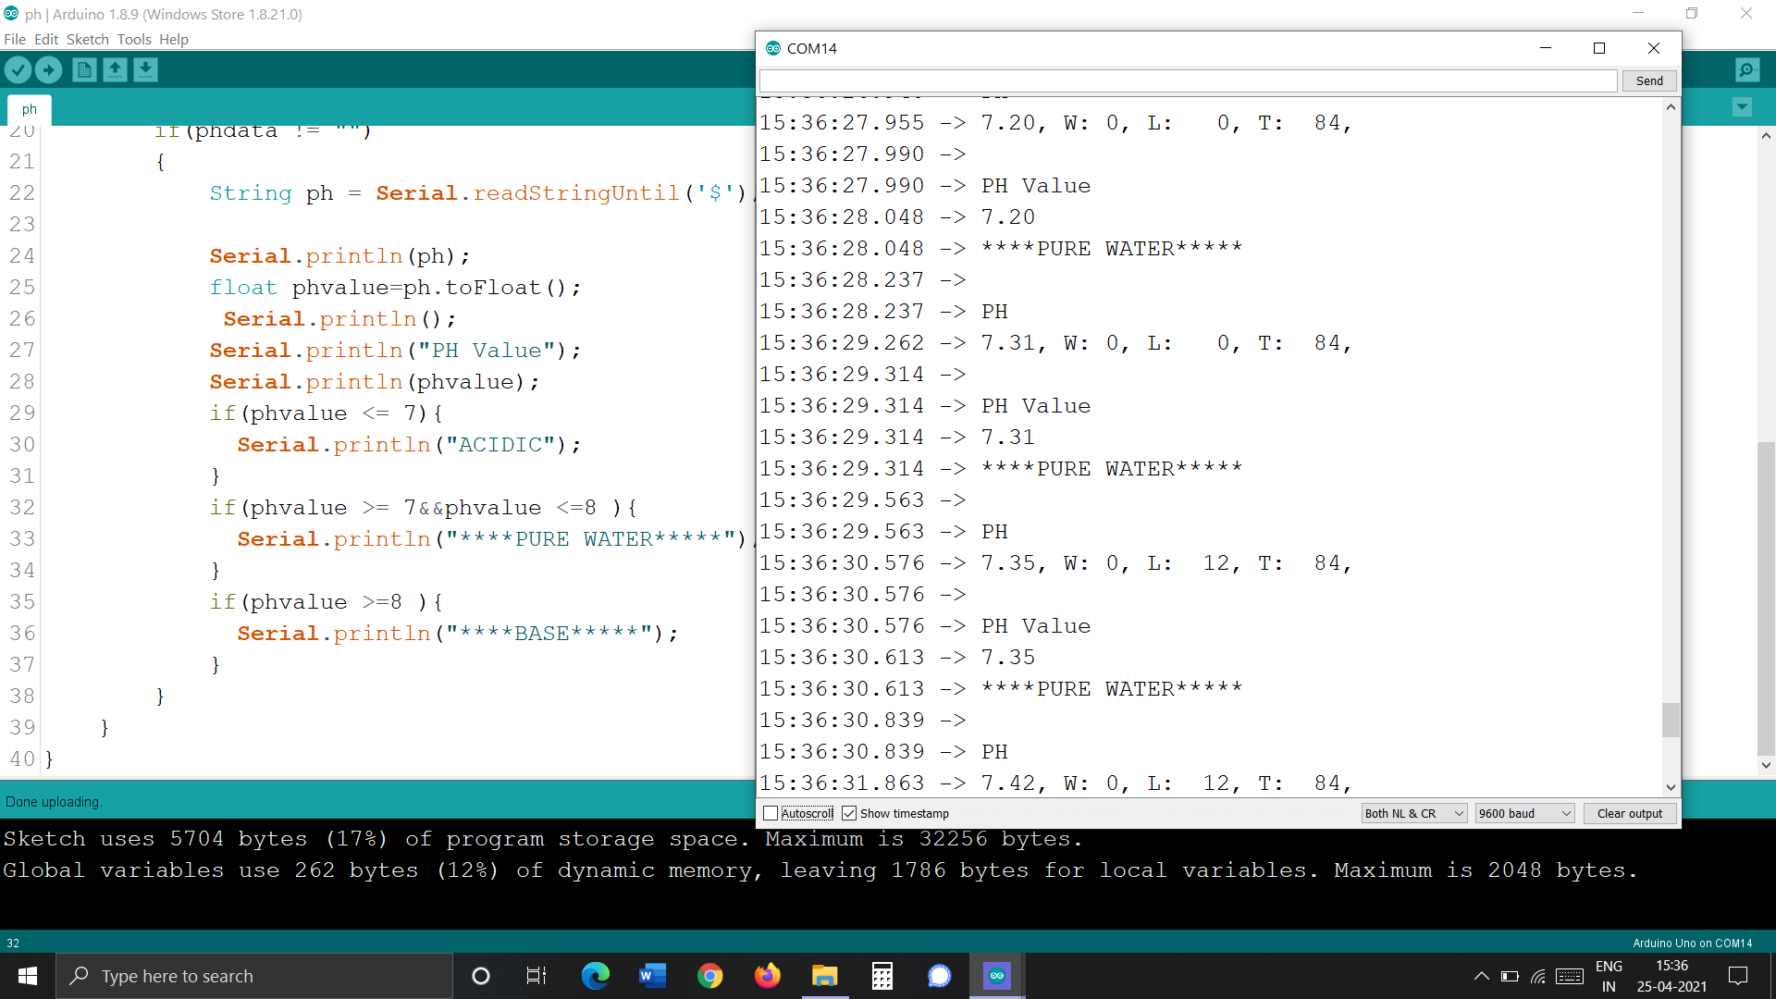
When dipped in Drinking water Values between “ 7 to 8 “ shows neutral
[ Pure water ]

Slide 27

When dipped in lemon water
Values above “ 7 “ shows Basic in nature

Slide 28
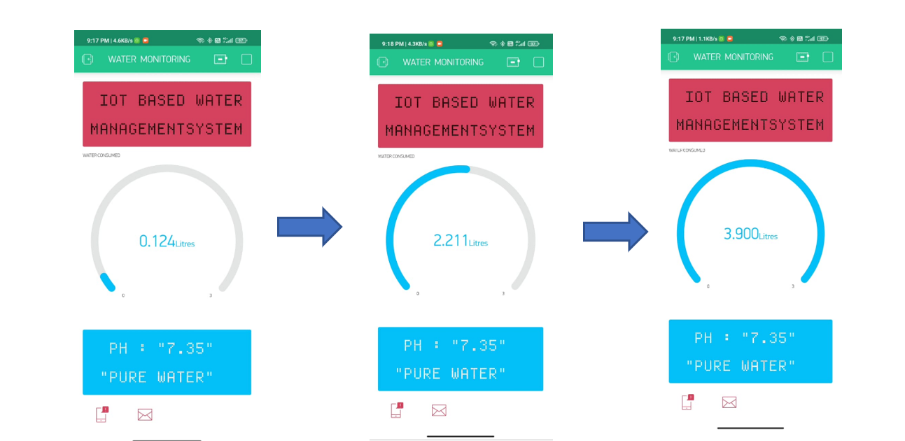
OUTPUT IN BLYNK APPLIACTION

Slide 29
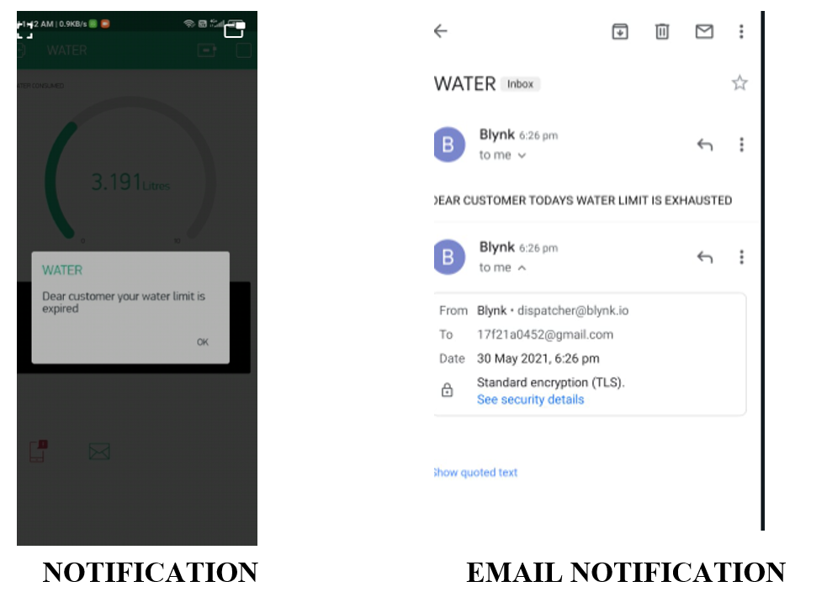
Notification and Email alert

Slide 30
Comparison between existing and proposed system
S. No | Parameters | IOT based Water management system using Arduino board (Existing system) | Low cost and latency IOT based Water based management system using ESP32(Proposed system)
1 | Number of components required | Five (Arduino, Flow sensor, Solenoid valve, Wi-Fi Module and PH sensor) | Four (ESP32, Flow sensor, Solenoid valve, and PH sensor.
2. | Processor speed | 1.6MHz | 2.4 GHz
3. | Latency | More | Less
4 | Cost of the system | More | Reduced to half of the existing system cost.
5 | Source code length |  | Less than that of the existing system source code length.
6. | Power consumption | 5 volts to 3.3 volts | 3.3 v

Slide 31
Advantages:
Wastage of Water can be minimized.
Integrated support for WIFI network.
Customer can see the data from their mobile.
Cost Effective.
Performance speed is High.
Low latency.
Low Power Consumption.

Slide 32
Conclusion:
The proposed implementation uses IoT enabled devices and provides end user with cost effective, portable and no need of an individual to monitor persistently from control room.
Suggested implementation successfully works within the vicinity of soft access point and can be easily implemented at the cost of meagre amount. Since ESP32 along with WIFI module is the main part of this design, automation is cheaper
Hence, to cope up with rapidly changing technology, IoT is the best solution for monitoring and controlling.

Slide 33
Future Scope:
The presented work can be extended by implementing request access for the customers, if people need excess amount of water. Further the water consumed by the customer is measured by using flow rate sensors and the amount should be paid by customers as per their usage of water measured by flow sensors.
In addition, instead of integrated Wi-Fi, configured as an access point, Long Range (LORA) wireless data communication technology can be implemented to overcome the limited vicinity issue.

Slide 34
Thank You ! !

